Slide 1
Data Analyst Nanodegree
Session 2
Conducted by: Hamza
Notes:
https://udacity.zoom.us/j/7991233356

Slide 2
Slack / SUPPORT / REPOs
https://join.slack.com/t/egypt-fwd-augusthq/shared_invite/zt-tml8ps50-PqlOgFnoTBEDL5L_~n8jtQ
fwd-support@udacity.com
https://github.com/santarabantoosoo/Data-Analysis-NanoDegree

Slide 3

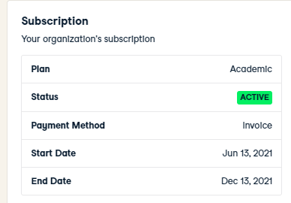

Slide 4
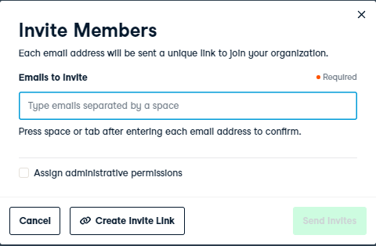
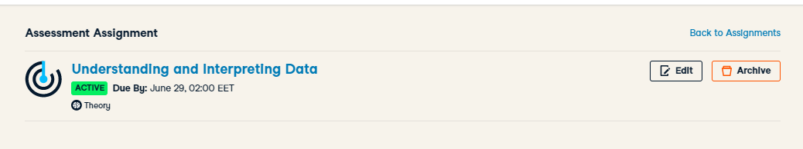
https://docs.google.com/spreadsheets/d/1VbURG9UQX4oaHhZeuHXW1FVdPLAUFhelfYK4f8N5z6c/edit#gid=0

Slide 5
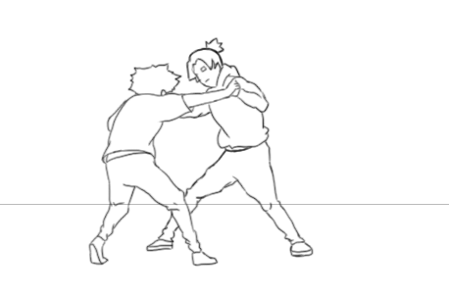
Competition

Slide 6
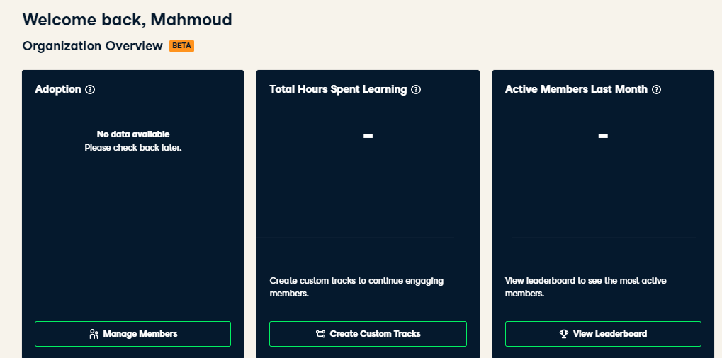
Compete within

Slide 7
agenda
Teaser solution
Descriptive stats … Lies?
Inferential stats .. Lies?
Explore dataset [breakout room]

Slide 8
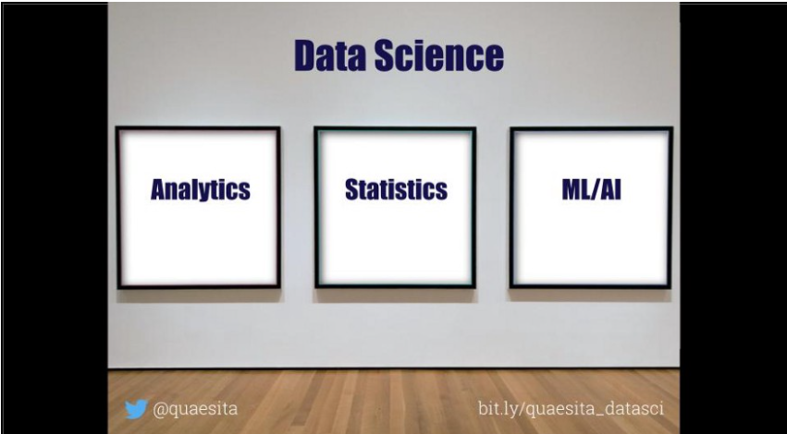
العركة؟
What’s the difference?

Slide 9



Analytics vs (statistics/AI/ML/DP)

Slide 10
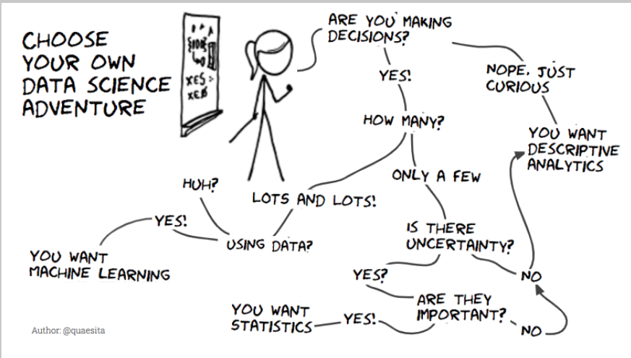

Slide 11
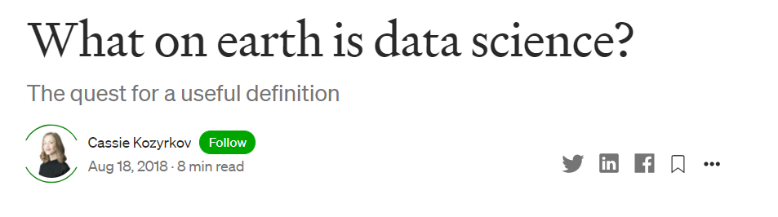
want more?
Notes:
What on earth is data science?. The quest for a useful definition | by Cassie Kozyrkov | HackerNoon.com | Medium
https://medium.com/hackernoon/what-on-earth-is-data-science-eb1237d8cb37

Slide 12
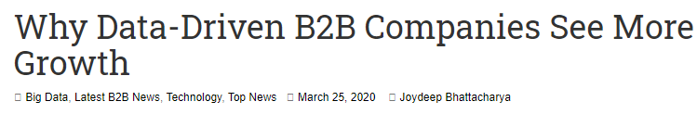

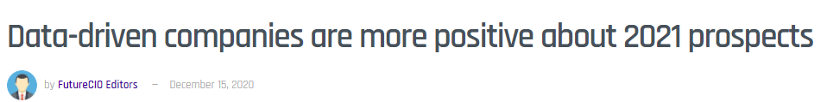
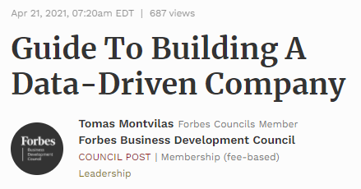
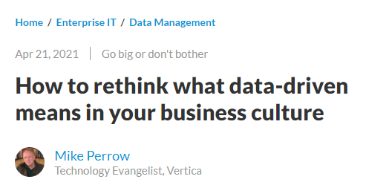

Slide 13

Data driven
Notes:
For a decision to be data-driven, it has to be the data — as opposed to something else entirely — that drive it. Seems so straightforward, and yet it’s so rare in practice because decision-makers lack a key psychological habit.
العربية الكارو محتاجة حمار عشان تبقى كارو

Slide 14

scenario
Notes:
Imagine that you are considering buying something online instead of making a pilgrimage to the other side of town to fetch it. You’ve boiled your decision down to whether or not you trust the online seller. A quick search yields some relevant data: you see that the seller has an average rating of 4.2 out of 5.

Slide 15
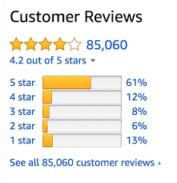
What u think?
Notes:
Now you can’t use that 4.2 to drive your decision. Game over! Once we’ve seen the answer, we’re free to pick the most convenient question. If the first thing we do is poke around in our data, our decision will be, at best, something I like to call data-inspired.

Slide 16
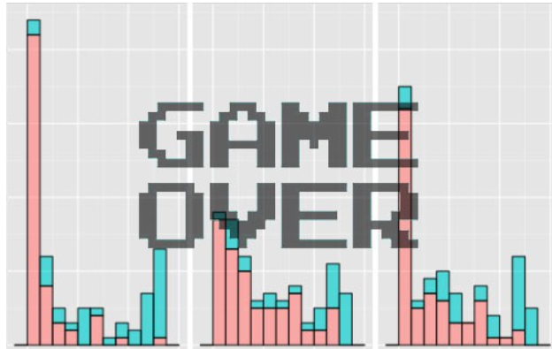
Data-drivenness destroyed
Any idea why?
Notes:
Once we’ve seen the answer, we’re free to pick the most convenient question

Slide 17
Data-drivenness destroyed
Once we’ve seen the
answer, we’re free to pick
the most convenient
question

Slide 18
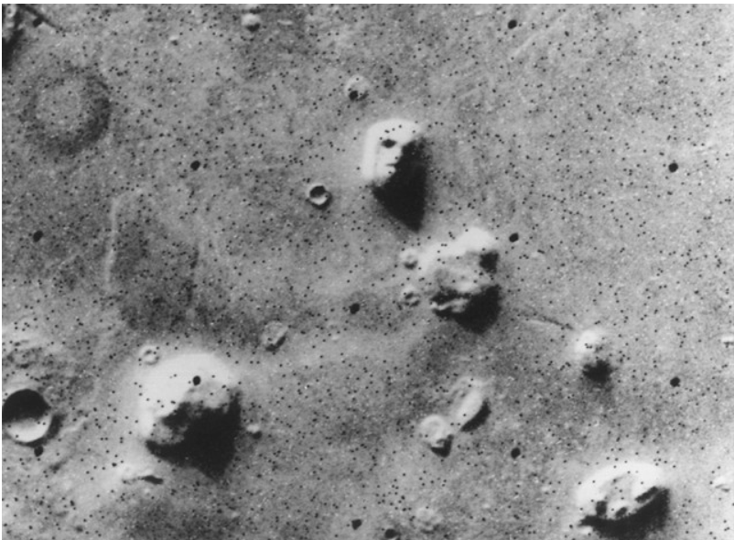

What u see, again?
12 sec shake?
Notes:
Satellite photo of the “Face on Mars” which many people took as evidence of extraterrestrial habitation.
How to know if there is indeed life on Mars? Test
How to know if 12 sec shake of ink can give u a butterfly image?
Retry

Slide 19
Notes:
Now you can’t use that 4.2 to drive your decision. Game over! Once we’ve seen the answer, we’re free to pick the most convenient question. If the first thing we do is poke around in our data, our decision will be, at best, something I like to call data-inspired.

Slide 20
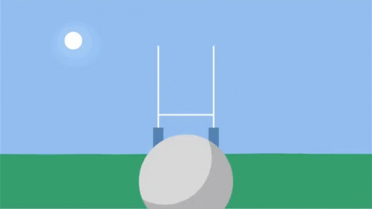
Problem
How to solve?
Notes:
Problem: you’re free to move the goalposts after you find out where the data landed. (Of course you score a goal every time. You’re just that good.)

Slide 21
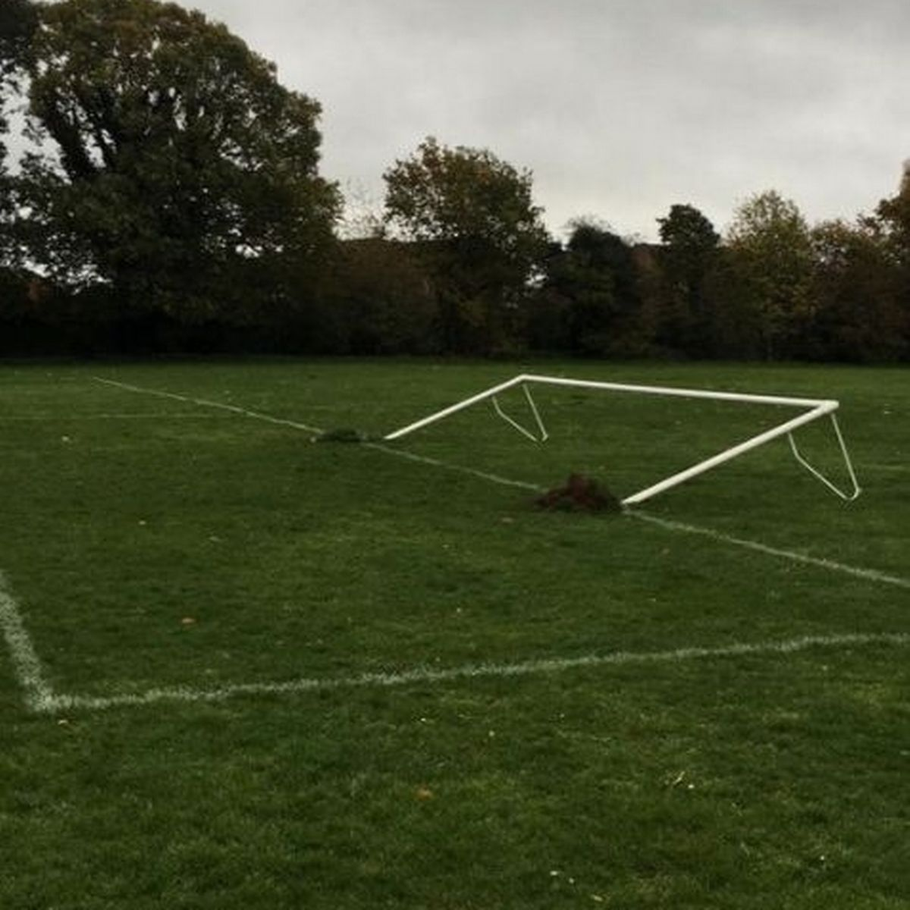

Solution
Notes:
set the goalposts in advance and resist temptation to move them later.
Framing the decision and setting decision criteria is a science of its own
a quick fix that goes a long way is to come up with your decision boundary up front in your data science project.
resis

Slide 22
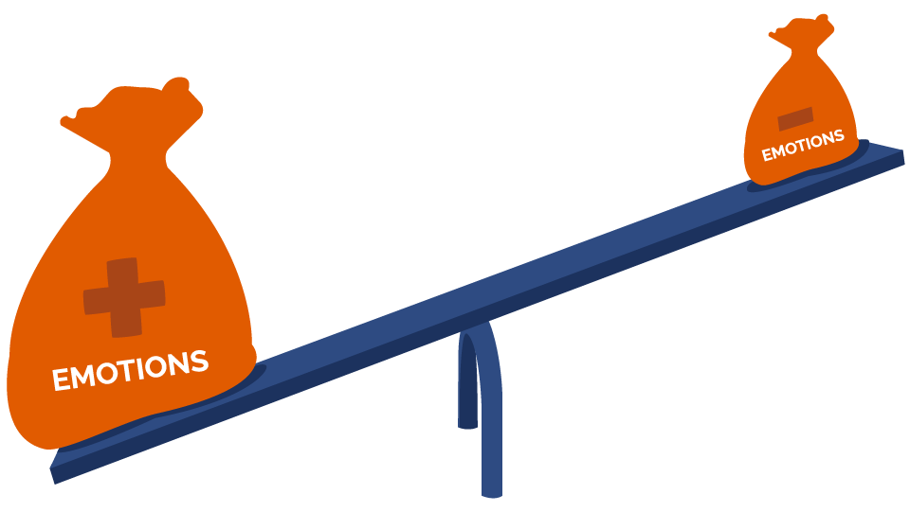

Notes:
That’s where we, like whales encountering plankton, swim around in some numbers, and then reach an emotional tipping point and… decide. There are numbers near our decision somewhere, but those numbers don’t drive it. The decision comes from somewhere else entirely.

Slide 23
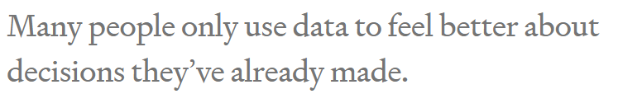

Slide 24
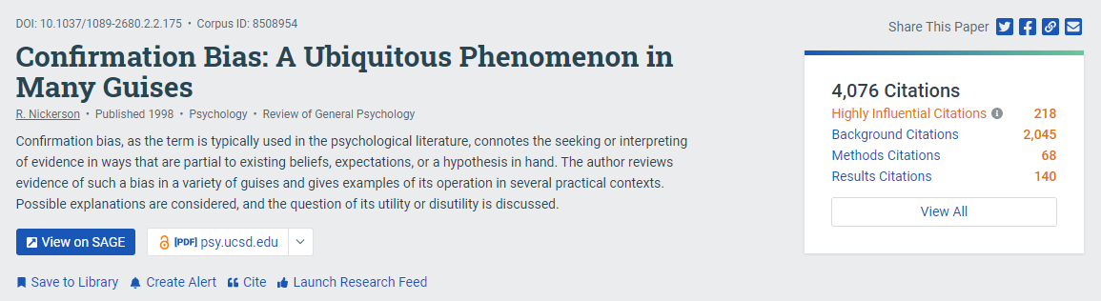
Notes:
The decision-maker’s mind was made up before the data, so the decision was there all along. Turns out humans interact with data selectively to confirm choices we’ve already made in our heart of hearts. We find the most convenient light in which to see evidence, and we don’t always know we’re doing it. Psychologists have a lovely name for this: confirmation bias.

Slide 25
Is it good?
Notes:
Positive
“It’s more than 4.0!”
They can even show a rigorous analysis about how it is statistically significantly higher than 4.0. (With certainty! It’s the p-value you’ve always wanted.)
Negative
“Why would I settle for a seller with less than 4.5 stars?” Or perhaps “But look at those 1-star reviews. I don’t like how many there are.” Sound familiar?

Slide 26
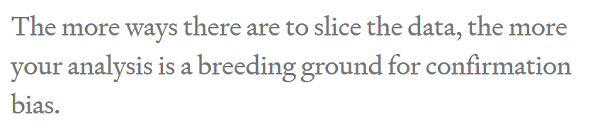

Slide 27

Solution
Notes:
Mathematical complexity doesn’t provide the antidote, it merely makes it harder to see the problem. As a result, what’s obvious in the trivial example we just saw becomes hidden in a jumble of gorgeous Gaussians. Don’t assume your friendly neighborhood data scientist sees it either. The more ways there are to slice the data, the more your analysis is a breeding ground for confirmation bias.

Slide 28
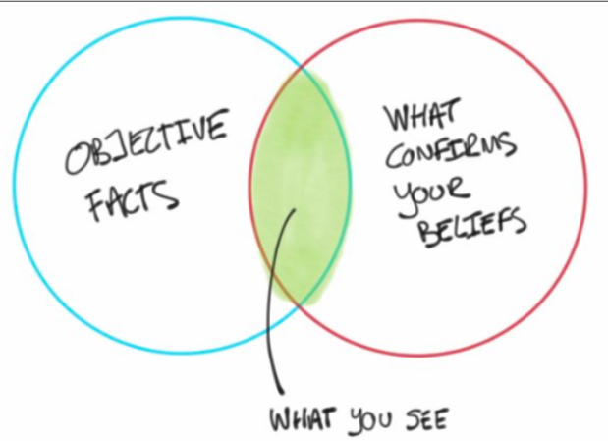
But why?

Slide 29

Notes:
feel better about doing what they were going to do anyway.

Slide 30


Any problem with real projects?
Notes:
It’s all about rating
What about a real pro

Slide 31
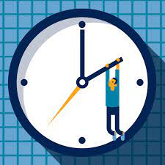


Expensive hobby

Slide 32

What’s the decision?
للأستاذة شيرين عبد الوهاب

Slide 33

Notes:
When decision-makers lack fundamental skills, there’s no math in the world that can fix it. Your data science team will not contribute to data-driven decision-making.

Slide 34

What if?
Notes:
nothing would be different if all those poor data scientists just made some numbers up

Slide 35
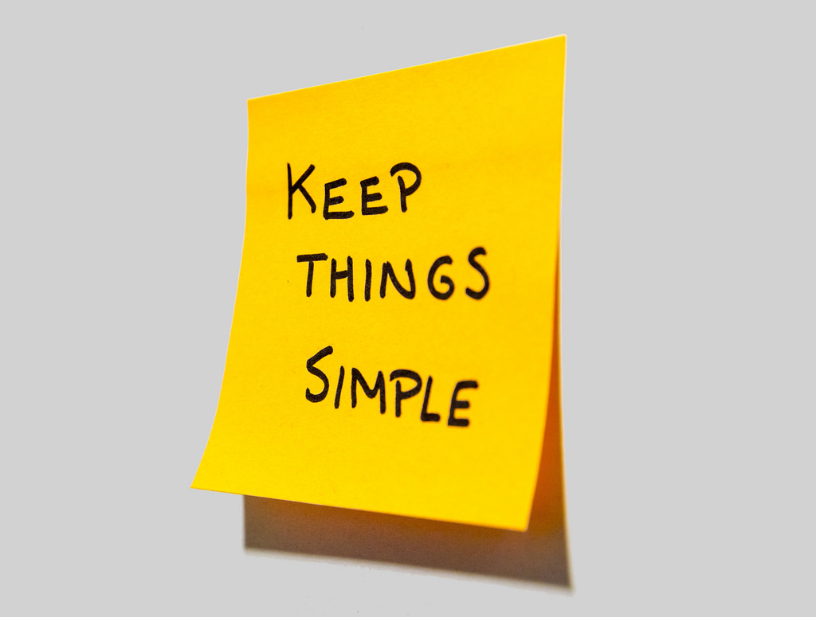

Cassie advice
Notes:
Data scientist friends, if your organization suffers from this kind of decision-maker, then I suggest sticking to the most lightweight and simple analyses to save time and money. Until the decision-makers are better trained, your showy mathematical jiu jitsu is producing nothing but dissipated heat.

Slide 36
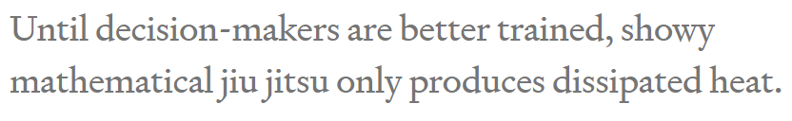

Slide 37
Problem
How to solve?
Notes:
Problem: you’re free to move the goalposts after you find out where the data landed. (Of course you score a goal every time. You’re just that good.)

Slide 38
Solution
Notes:
set the goalposts in advance and resist temptation to move them later.
Framing the decision and setting decision criteria is a science of its own
a quick fix that goes a long way is to come up with your decision boundary up front in your data science project.
resis

Slide 39

Practice
How to set goal first?

Slide 40

Solution
Notes:
she tugs at the pricetag on the back. “Hey, what does this say?” she asks me. “If it’s less than 80 bucks, I’ll buy it.”

Slide 41

Order matters
Notes:
Now that’s some decision intelligence! Instead of first seeing the price and then talking herself into a decision she’s already made, she uses the data to drive it. With a well-practiced reflex, she weighs how much she likes the dress and her budget, then sets the decision boundary, and only allows herself to see the data (price) once that’s done. She’s in the habit of using data in the right order and that’s a muscle you can exercise too.

Slide 42
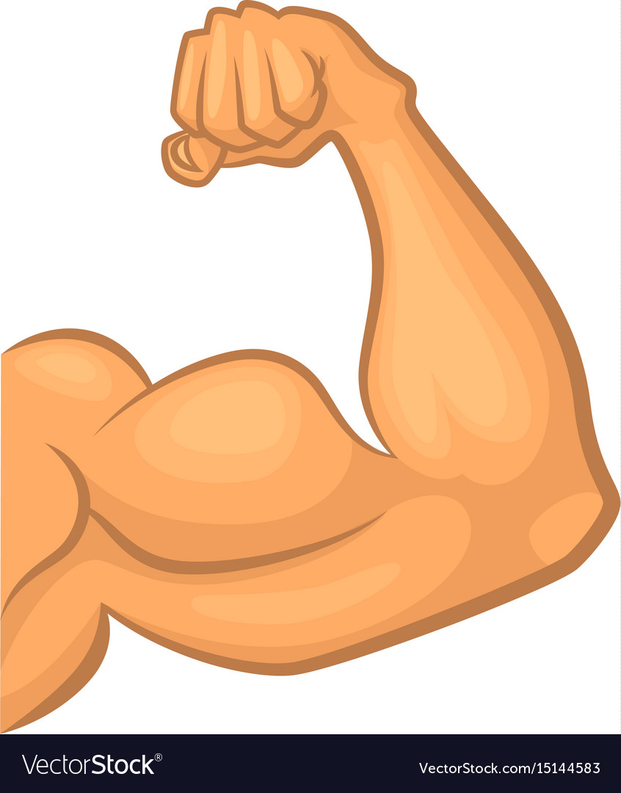
Practice your data driven muscle
Notes:
People don’t always need to be data-driven and Emma knows that. She doesn’t have to make unimportant decisions that way, but she also knows that practice makes perfect. It’s much easier to build the habit on trivial decisions than to struggle when the important ones come around.

Slide 43

Negotiation 101
Notes:
I went to buy fireworks
I sticked to 80 pounds

Slide 44

What if I didn’t ?

Slide 45
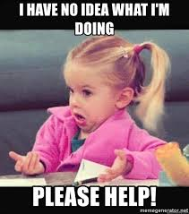
Notes:
In fact, standard advice for negotiators is to think through the entire range of potential offer combinations and plan your reactions to them in advance, otherwise it’s very easy for an experienced opponent to take advantage of you. Even without all the persuasion tactics at your counterpart’s disposal, irrelevant short-term factors like your blood sugar levels, your mood, how much the other party is smiling, and whether the sun is shining can have a disproportionate effect on the deal.

Slide 46
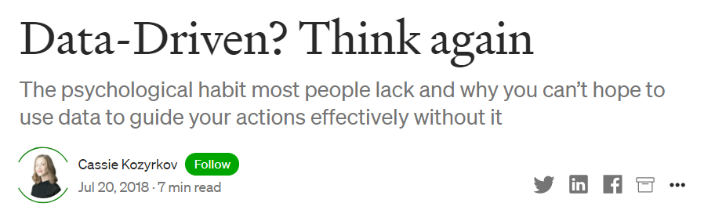
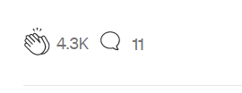
Notes:
Data-Driven? Think again. The psychological habit most people… | by Cassie Kozyrkov | HackerNoon.com | Medium
https://medium.com/hackernoon/data-inspired-5c78db3999b2

Slide 47
Topics in sessions
Quant vs cat
Ordinal vs nominal
Cont vs discrete
Centrality and spread
Random variable
Outliers
Desc vs inf stats

Slide 48
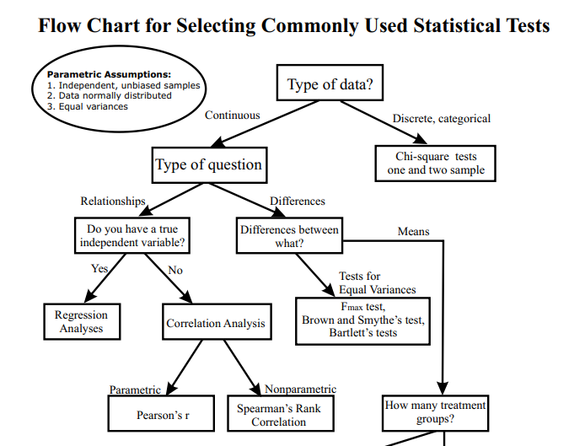
انت جاي تعمل ايه؟

Slide 49
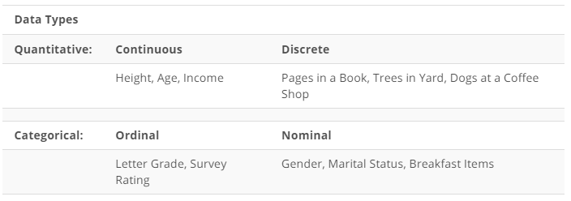

Slide 50
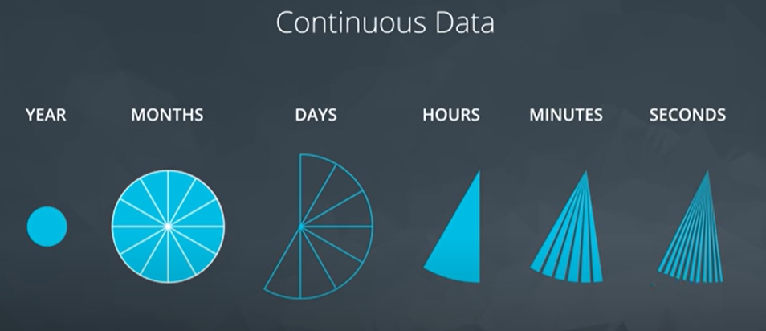
Notes:
What about discrete data?

Slide 51
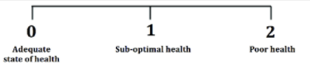
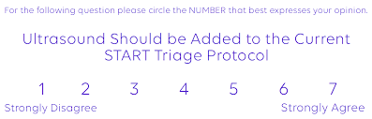
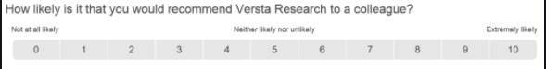
Data type
Notes:
Which can be converted to continuous ?
3 points … never
7 points … maybe
10 points .. Probably yes

Slide 52
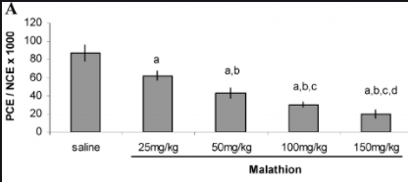
Data type
Notes:
Ordinal or nominal?
I think nominal..
But maybe if we changed saline to 0
Maybe it turns to be ordinal

Slide 53
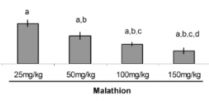
Data type
Notes:
Can be Nominal or ordinal

Slide 54
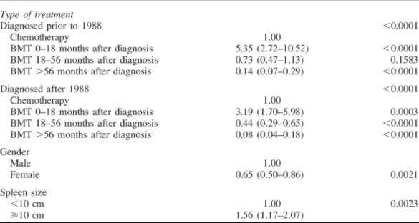
Bone marrow transplantation
Notes:
Spleen size> what’s the data type
Formerly : continuous
Then categorical
Time from bmt to diagnosis
Continuous then categorical maybe ordinal
Is it outcome variable … ordinal makes sense
Is it a predictor . Maybe order matters, like Cochrane Armitage

Slide 55
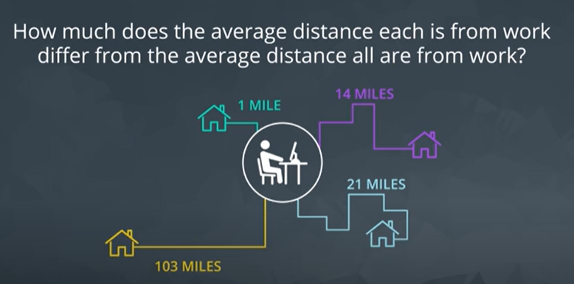
Standard deviation
Notes:
Standard deviation
Just a single estimate for the data spread

Slide 56
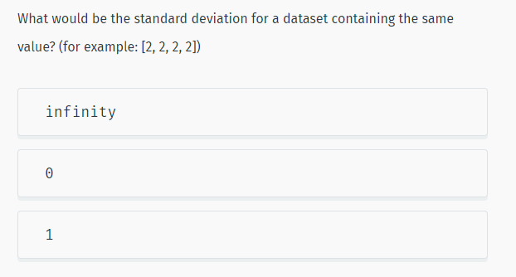
Notes:
More Statistics | SoloLearn
https://www.sololearn.com/learning/1161/4778/12271/2

Slide 57
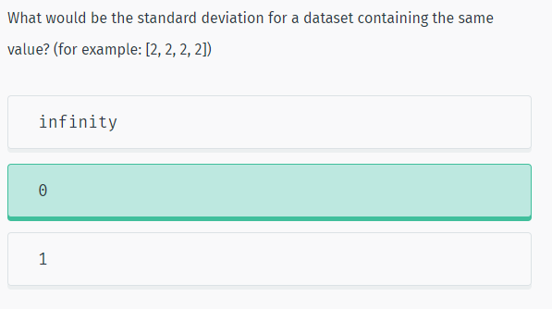
Solution

Slide 58
How to choose?
Range vs IQR
Mean vs median
Notes:
When to choose boxplot over histogram?
Normality : mean
Skewed : median /IQR / maybe range if no outliers
Outliers : IQR

Slide 59
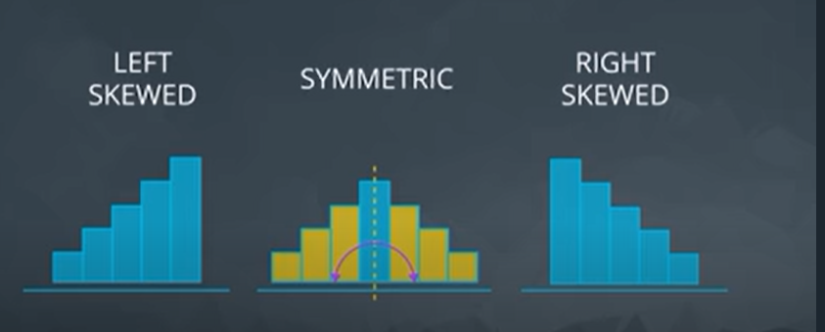
solution

Slide 60
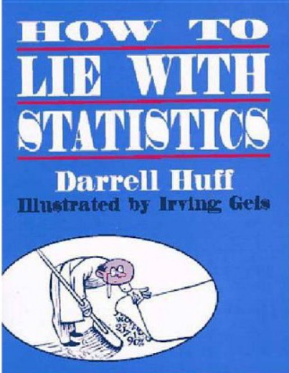
65 years old

Slide 61


Two hospitals
100 child per day
10 child per day

Slide 62
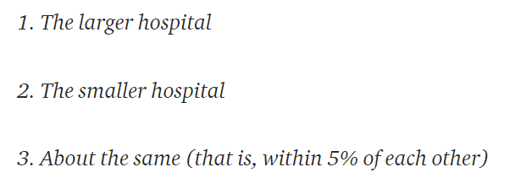
Hospital with more boys?
For 1 year, each hospital recorded no. of days where 60% of the babies born were boys.
- Which hospital do you think recorded more such days?
Notes:
A certain town is served by two hospitals. In the larger hospital, about 45 babies are born each day, and in the smaller hospital, about 15 babies are born each day. As you know, about 50% of all babies are boys. However, the exact percentage varies from day to day. Sometimes it may be higher than 50%, sometimes lower.
For a period of 1 year, each hospital recorded the days on which more than 60% of the babies born were boys. Which hospital do you think recorded more such days?
If you guessed 2., then congratulations, you are data literate! The reasoning is the smaller the sample size, the more extreme the values.

Slide 63

4 heads out of 5?
Notes:
You can test the principle that small samples produce extreme results by flipping a coin. With a small sample, say 5 tosses, there is a good chance you get 4 tails. Does this mean the coin always comes up 80% tails? No, this means your sample is too small to draw any significant conclusions.
This trick is often used when marketing products by asking a small number of people about a particular brand. You can get impressive-sounding numbers (90% of doctors like this toothpaste) if you repeatedly survey small groups and only report the favorable results. Ask a small group, look at the results, throw away the bad, and repeat until you get the stats you need!

Slide 64
Conclusion?
Small Samples Produce Shocking Statistics
Avoid fishing

Slide 65
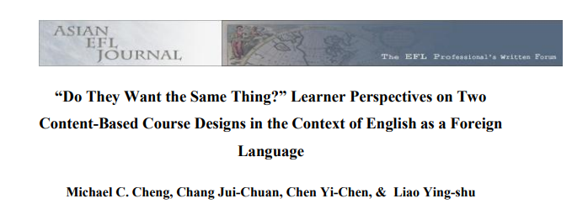
Academic papers?
“over70 percent of the students preferred language-skills courses over other courses”
“of the 41 percent who planned to seek employment, an overwhelming majority of respondents (82%)disliked the idea of content-driven design (Design 1)”
Notes:
In their study on learner perspectives in the context of English as a ForeignLanguage, Cheng, Jui-Chuan, Yi-Chen and Ying-shu (2010: 79) found that “over70 percent of the students preferred language-skills courses” over other courses, which seems quite a lot. They furthermore add that “of the 41 percent who plannedto seek employment, an overwhelming majority of respondents (82%)disliked theidea of content-driven design (Design 1)” (Cheng et al. 2010: 80). The reader hasto be very diligent here and go back to the methodology section where the authorsexplain that they included only 96 participants in their study, which is“approximately 35% of the target population” (Cheng et al. 2010: 75). Hence, from274 students, a number that was not directly stated, the authors were able to ask96, which means that 35% represent the target group. From these 96 students, 41%“plan to seek employment”. This makes 39 students. 82% of these 39 students,meaning 32 students, are described as “an overwhelming majority” who “dislikedthe idea of content-driven design” (Cheng et al. 2010: 80). In the end, however,the authors only refer to 32 out of274 students. “Overwhelming” does thereforedefinitely not seem fitting. This example shows that students should be aware thatthe reference sample might be quite small and not be of importance yet still beemphasised in several studies. It should not be confused with the larger overallsample.
(11) (PDF) Statistics Can Lie! – Using Descriptive Statistics in Academic Writing to Shape Reader’s Interpretations | Jessica Dheskali - Academia.edu
https://www.academia.edu/43624921/Statistics_Can_Lie_Using_Descriptive_Statistics_in_Academic_Writing_to_Shape_Reader_s_Interpretations

Slide 66
Back to methodology section
274 students
“over70 percent of the students preferred language-skills courses over other courses”
“of the 41 percent who planned to seek employment, an overwhelming majority of respondents (82%)disliked the idea of content-driven design (Design 1)”
96 participants
39 students
32 students
Notes:
In their study on learner perspectives in the context of English as a ForeignLanguage, Cheng, Jui-Chuan, Yi-Chen and Ying-shu (2010: 79) found that “over70 percent of the students preferred language-skills courses” over other courses, which seems quite a lot. They furthermore add that “of the 41 percent who plannedto seek employment, an overwhelming majority of respondents (82%)disliked theidea of content-driven design (Design 1)” (Cheng et al. 2010: 80). The reader hasto be very diligent here and go back to the methodology section where the authorsexplain that they included only 96 participants in their study, which is“approximately 35% of the target population” (Cheng et al. 2010: 75). Hence, from274 students, a number that was not directly stated, the authors were able to ask96, which means that 35% represent the target group. From these 96 students, 41%“plan to seek employment”. This makes 39 students. 82% of these 39 students,meaning 32 students, are described as “an overwhelming majority” who “dislikedthe idea of content-driven design” (Cheng et al. 2010: 80). In the end, however,the authors only refer to 32 out of274 students. “Overwhelming” does thereforedefinitely not seem fitting. This example shows that students should be aware thatthe reference sample might be quite small and not be of importance yet still beemphasised in several studies. It should not be confused with the larger overallsample.
(11) (PDF) Statistics Can Lie! – Using Descriptive Statistics in Academic Writing to Shape Reader’s Interpretations | Jessica Dheskali - Academia.edu
https://www.academia.edu/43624921/Statistics_Can_Lie_Using_Descriptive_Statistics_in_Academic_Writing_to_Shape_Reader_s_Interpretations

Slide 67
Conclusion?
Small numbers again
Beware of percentages!

Slide 68



Iq test
Notes:
two children, one of whom tests a 99 on IQ and the other a 102, you really should not tell them to avoid comparisons. Why? Because IQ tests can have a standard error of around 3 points which means a child scoring a 99 once would be expected to score between 96 and 102 about 68% of the time. The overall difference might not be significant and could reverse itself in repeated testing. In other words, by leaving out the expected standard error in the results, you can draw a more drastic conclusion than that offered by the data.

Slide 69
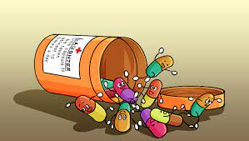
increased lifespan by 2 years on average
Notes:
Think of it this way: if there was a medicine that increased lifespan by 2 years on average would you take it? Would it change your mind if the worst impact was a loss of 12 years of life and the maximum a gain of 14 years? It usually is the details that matter and one summary statistic cannot tell the whole story.

Slide 70
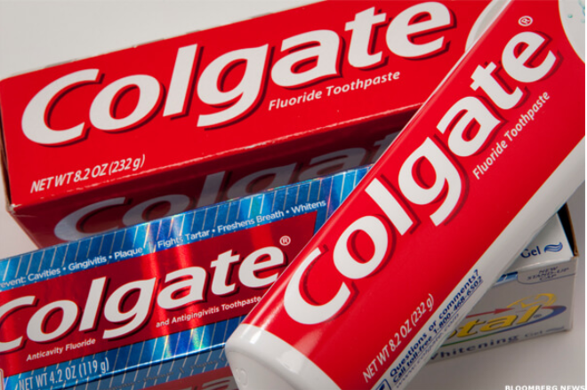
More than 80% of Dentists recommend Colgate
Notes:
Misleading Statistics & Data – News Examples For Misuse of Statistics
https://www.datapine.com/blog/misleading-statistics-and-data/

Slide 71
More than 80% of Dentists recommend Colgate
In 2007, Colgate was ordered by the
Advertising Standards Authority (ASA)
of the U.K. to abandon their claim
Why?

Slide 72
The question
Which toothpaste do u recommened? (more than 1 answer possible)
colgate
sensodyne
Miswak
…
Notes:
The claim, which was based on surveys of dentists and hygienists carried out by the manufacturer, was found to be misrepresentative as it allowed the participants to select one or more toothpaste brands. The ASA stated that the claim “… would be understood by readers to mean that 80 percent of dentists recommend Colgate over and above other brands, and the remaining 20 percent would recommend different brands.”

Slide 73

misleading
Come back ☺
Small numbers??
Notes:
The ASA continued, “Because we understood that another competitor’s brand was recommended almost as much as the Colgate brand by the dentists surveyed, we concluded that the claim misleadingly implied 80 percent of dentists recommend Colgate toothpaste in preference to all other brands.” The ASA also claimed that the scripts used for the survey informed the participants that the research was being performed by an independent research company, which was inherently false.
Maybe small numbers of surveys is also a similar problem
U survey 10 dentists. By chance u get very good results. U keep them
And remove other results that were unfavorable

Slide 74
Conclusion?
Multiple answer questions …. A totally different scenario!

Slide 75
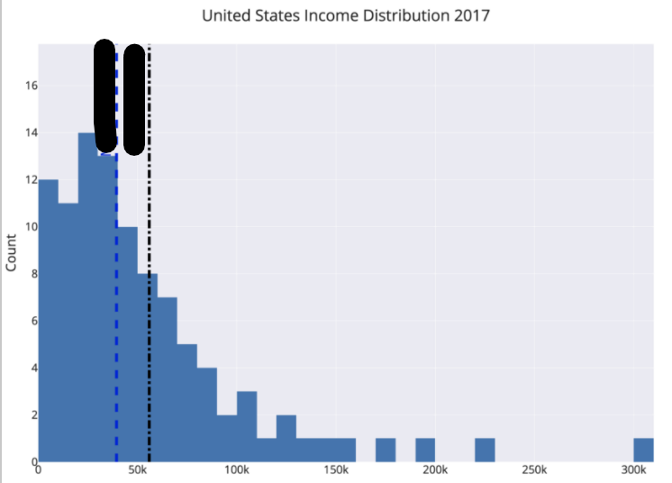
Where is the mean?

Slide 76
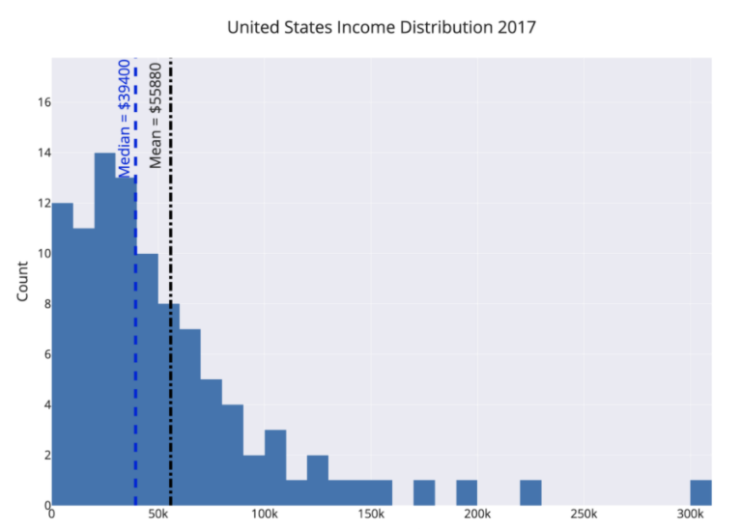
politicians, marketers,
and CEOs
Notes:
For example, the mean and median income in the United States differ by about $16,000. By choosing which value to report as the average, politicians, marketers, and CEOs can draw opposing conclusions from the same data.
How to avoid?
The way to avoid this is to look at the mean, median, and mode of a dataset (again you need all these numbers!). Figure out which one is most appropriate (usually the median for highly skewed datasets such as income, city size, life span, housing prices and so on) and use that if you need a one figure summary. If you can, graph the entire set of values in a histogram and look at the distribution. Try to use more than a single number to describe a dataset, and if you report an average, specify which you are using!

Slide 77
90% of Drivers Consider Themselves Above Average
What u think?
Notes:
wow, other people are terrible at evaluating themselves objectively.”
Although a headline like this is often used to illustrate the illusion of superiority, (where people overestimate their competence) it also provides a useful lesson in clarifying your assertions when you talk statistics about data. In this particular case, we need to differentiate between the mean and median of a set of values. Depending on the question we ask, it is possible for 9/10 drivers to be above average.
How 90% of Drivers Can be “Above Average” or Why You Need to be Careful When Using Statistics | by Will Koehrsen | Towards Data Science
https://towardsdatascience.com/how-90-of-drivers-can-be-above-average-or-why-you-need-to-be-careful-when-talking-statistics-3df7be5cb116

Slide 78
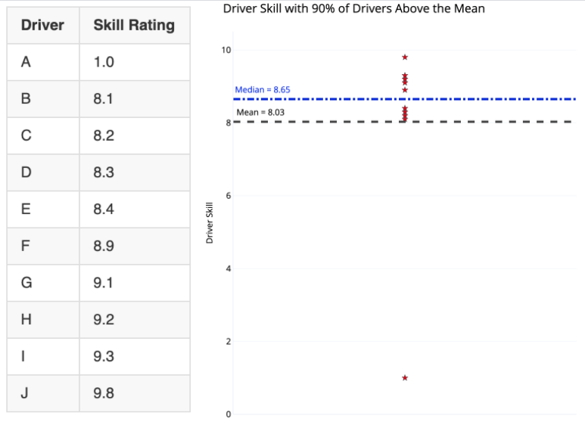
And now?
What do we call this point?
Notes:
The distinction is whether we use mean or median for “average” driver skill. Using the mean, we add up all the values and divide by the number of values, giving us 8.03 for this dataset. Since 9 of the 10 drivers have a skill rating greater than this, 90% of the drivers could be considered above average!
The median, in contrast, is found by ordering the values from lowest to highest and selecting the value where half the data points are smaller and half are larger. Here it’s 8.65 with 5 drivers below and 5 above. By definition, 50% of drivers are below the median and 50% exceed the median. If the question is “do you consider yourself better than 50% of other drivers?” than 90+% of drivers cannot truthfully answer in the affirmative.
outlier

Slide 79
Makes sense?
“Majority of people live longer than average”
Notes:
An example of a negatively skewed distribution is age at death. In this dataset, there are, unfortunately, some deaths at a relatively young age, lowering the mean and skewing the graph leftward (negatively).
In the case of a negative skew, the median is greater than the mean. The result is that more people can be above the “average” when the average is defined as mean. “Majority of people live longer than average” might be a strange headline, but if you choose your stats carefully, you can make it true.

Slide 80

Makes sense?
“Majority of people live longer than average”
Notes:
An example of a negatively skewed distribution is age at death. In this dataset, there are, unfortunately, some deaths at a relatively young age, lowering the mean and skewing the graph leftward (negatively).
In the case of a negative skew, the median is greater than the mean. The result is that more people can be above the “average” when the average is defined as mean. “Majority of people live longer than average” might be a strange headline, but if you choose your stats carefully, you can make it true.

Slide 81
Conclusion?
When to use mean/median?

Slide 82

☹ ☹
289 murders in 2018

Slide 83
Context ☺ ☺
289 murders in 2018
2245 murders in 1990
Notes:
You can scare people by saying New York had 289 murders in 2018, but when you compare that to 2245 in 1990, you realize New York City has never been safer! It’s usually the comparison that matters; don’t let an isolated number sway your rational thinking.

Slide 84

Unemployment
2019 20%
2020 13%

Slide 85

Changed definition
Notes:
The easiest way to lower unemployment is just to change the definition to exclude people who have stopped looking for work.

Slide 86
Conclusion?
Always have a reference
Check definitions and ensure their consistency

Slide 87
Don’t Place Too Much Faith in any One Statistic
“How to Lie with Statistics” ➔ view any single statistic with skepticism.
Any number represents a distillation of a set of data, which was taken on a sample of a population by mistake-prone humans, using imperfect tools, in constantly changing conditions at a single point in time.
Notes:
The overall theme of “How to Lie with Statistics” is: view any single statistic with skepticism.
Any number represents a distillation of a set of data, which was taken on a sample of a population by mistake-prone humans, using imperfect tools, in constantly changing conditions at a single point in time.

Slide 88
Enough?
The data was analyzed by another human, who works for an institution, which may have outside funders with differing motivations. Finally, the statistic or graph was delivered to you by a publisher that has its own interests in getting you to believe one idea.
Notes:
All this leads to two conclusions:
If you put all your faith in one number, then you will be overfitting to the particular circumstances that produced the number.
Statistics and data are never purely objective. A statistic is one interpretation of uncertain data designed to persuade.
We should look for the range of values, report numbers with confidence intervals, gather more data before jumping to conclusions, compare multiple studies, and ask about the design of the data-gathering process

Slide 89

Want to learn more?
Notes:
Lessons on How to Lie with Statistics | by Will Koehrsen | Towards Data Science
https://towardsdatascience.com/lessons-from-how-to-lie-with-statistics-57060c0d2f19

Slide 90
Enough lies. Let’s work!
How to conduct descriptive statistics?
How to make ur life easier?

Slide 91


Real life

Slide 92



Different specialties

Slide 93

https://pypi.org/project/tableone/
Notes:
tableone · PyPI
https://pypi.org/project/tableone/

Slide 94



What happened?
Notes:
Continuous variables : mean SD
Categorical variables : frequency percentage
Grouped by outcome

Slide 95

More flexibility?
http://www.danieldsjoberg.com/gtsummary/
Notes:
Presentation-Ready Data Summary and Analytic Result Tables • gtsummary
http://www.danieldsjoberg.com/gtsummary/

Slide 96


Slide 97




Slide 98










Useful notebook extensions
Notes:
10 Jupyter Notebook Extensions Making My Lyfe Easier | by Max Tingle | Medium
https://medium.com/@maxtingle/10-jupyter-notebook-extensions-making-my-lyfe-easier-f40139a334ce
If you want to view the full traceback, you can click the triangle/drop-down arrow at the end of the summary to unhide the traceback.
Ever find yourself adding a bunch of cells in your notebook to test code as you debug? And do those cells just get in the way later?
Once enabled, Scratchpad is a cell that acts like a scratch notebook where you can execute code against the kernel without having to modify your notebook. Scratchpad cells are executed using “Shift+Enter” like a regular cell, and you can use the icon in the bottom-right of the screen or the keyboard shortcut “Ctrl+B” to toggle Scratchpad.
And this is where extensions really start doing the work for you. The Snippets Menu extension adds a menu item to your Jupyter Notebook where you can search for snippets, boilerplate, and examples of code to insert into your notebook.
The first time you open a notebook with initialization cells enabled, a warning will display saying the notebook is untrusted. You can choose to trust the notebook, after which the notebook will re-open in trusted mode and run your initialization cells.
Turn on the cell toolbar within your notebook menu using “View > Cell Toolbar > Initialization Cell.”

Slide 99

RUN ALL CELLS?

Slide 100


Inferential statistics

Slide 101


Notes:
Get more examples

Slide 102

Conduct a study!

Slide 103
What u think?
“A statewide antibody study estimates that 21% of New York City residents have had the coronavirus, Cuomo says.”

Slide 104

Trust ☺
Notes:
Ya3ny eh?
If lopsided results are misleading, that doesn’t necessarily mean that they were born out of the intent to mislead. Perhaps they were, perhaps they weren’t. Statistical bias can come about through negligence, ignorance, expediancy, or shenanigans.

Slide 105

What is bias?
What’s variance?

Slide 106

Notes:
High bias doesn’t mean you’re shooting all over the place (that’s high variance), but may cause a perfect archer hit below the bullseye all the time.

Slide 107


Slide 108
Bias/variance? Over or under?
“A statewide antibody study estimates that 21% of New York City residents have had the coronavirus, Cuomo says.”
What u think?
Notes:
Over or under estimation?
Over estimation
The true is low
Why? I smell the pungent odor of randomization issues with how the data were obtained, which brings me to statistical subdefinition #2.

Slide 109

Indoor?
Notes:
What clever thing did they do to collect data from people who stay indoors?
As it turns out, no clever thing.

Slide 110
Questions to ask?
What’s the probability the study measured someone who is fully self-quarantined?
How many NYC residents are keeping themselves entirely to themselves?
Notes:
Zero.
We don’t know.

Slide 111

conclusion
Notes:
Selection bias
A special way to trigger results that are systematically off the mark is to collect your data in a problematic manner. For statisticians who love having things to be grumpy about, selection bias is a cherished frenemy. It visits so often!
Selection bias occurs when different members of your population of interest have different probabilities of arriving in your sample.
In other words, you’re making conclusions from your sample as if it were drawn randomly while it was drawn, er, “randomly” instead.

Slide 112

Notes:
In that case, your sample isn’t representative of your population… which makes your conclusions untrustworthy.
If your population of interest is all New York City residents, then you don’t have a random sample (SRS) unless every single New York City resident has equal probability of being included. Is that requirement met by the NY antibody study? Definitely not.

Slide 113
Undercoverage bias
How to solve?

Slide 114

Solution
“all NYC residents who go outside”
Notes:
One pragmatic quick fix for undercoverage bias is to settle for a less ambitious population definition. Instead of trying to make inferences about “all NYC residents” you could choose instead to talk about “all NYC residents who go outside” — problem solved!

Slide 115

Now fixed?
The study tested people “at
grocery and big-box stores.”
Any problem?
Notes:
Let’s see how the data were gathered. The study tested people “at grocery and big-box stores.” If you’d like increase your probability of exposure, where do you go? To places with a higher density of people, like grocery and big-box stores. Where was the study done? Yup.

Slide 116

Grocery frequent visits
Notes:
How about if you really, really, really want to get the virus? You might go to grocery and big-box stores frequently… more frequently than someone who’s trying to reduce their probability of infection. Of these two kinds of people, which kind of person would be more likely to have COVID-19 antibodies? Which do you think would be more likely to be in the right place at the right time to participate in the study? Hello, selection bias!

Slide 117

volunteer bias ?
Notes:
volunteer bias because he suspects he was infected, or currently infected

Slide 118
How to solve?
Notes:
Biased archers have it easy — if you keep hitting the target above the center, at least you can see it and make adjustments. Researchers with selection bias aren’t so lucky. Selection bias means all your results are wrong and you don’t know how wrong.

Slide 119

No Solution ☹

Slide 120

Notes:
Is this enough?

Slide 121

Biased conclusions
PCR sensitivity
threshold
Notes:
information bias occurs when measurements are systematically incorrect.
Have u heard of PCR sensitivity?
What if they only detect antibodies above a strict threshold to avoid false alarms?

Slide 122
Information vs selection
خالصين ؟

Slide 123
Conclusion about population?
What do we know about NYC residents’ actual exposure rate?
Notes:
Exposure rate : we know Nothing

Slide 124
Conclusion about population?
What do we know about NYC residents’ actual exposure rate?
- What do we know for sure?
Notes:
What we know for sure?
Some people at grocery and big box stores got an exciting readout from something called an antibody test.

Slide 125
Business Insider
“preliminary”
sampling issues
So where is the problem?
Notes:
To be fair to Business Insider, I think they did a pretty good job of reporting. They even called the results “preliminary” and mentioned some of the same sampling issues I talked about. Kudos! These are the same properly-cautious noises originally made by the governor of NY and the team who ran the study. I have no beef with them either. Instead, my complaint is with the broken telephone game that the rest of the internet is playing.

Slide 126


What is the problem?
Soret el telephone el 5arban
Notes:
Instead, my complaint is with the broken telephone game that the rest of the internet is playing.

Slide 127

Most common
1- Read all article?
2- say I haven’t read
3- report the title only?
Notes:
What most frequently occurs on whatsapp?
Report the title only.

Slide 128

Reporting bias

Slide 129
When reporting bias happens?
Journal club?
Twitter?
Trick
Feel better
Advertising a scientific article
Notes:
Make pithy summaries of complicated things (e.g. to squeeze everything into a 280 character tweet).
Prevent readers’ eyes from glazing over (e.g. journalists editorializing scientific publications).
Persuade someone through trickery (e.g. conveniently “forgetting” to mention studies that cast doubt on the arguments you’re hoping to make).
Feel better about their opinions (e.g. when they’re suffering from confirmation bias).

Slide 130
Is the study worthless?
Notes:
Does this mean that the study is worthless? No, but it’s only as good as the assumptions you’ll make about it. Since there’s very little that we know for sure from its data, the only way to make inferences beyond the facts is to bridge the gap with assumptions. That’s all statistics is. Assumptions, not magic.
Unfortunately, we’re not all equally qualified to make good assumptions that lead to useful conclusions. For example, while I am a statistician with plenty of real-world data collection experience, I’m not an expert in antibody tests, so you shouldn’t trust me to make wise assumptions about their accuracy. Excellent! I don’t trust me either, so I’ll end up learning nothing about the virus exposure rate of NYC. The study is worthless in my hands.

Slide 131
Is the study worthless?
As good as the assumptions
Notes:
Does this mean that the study is worthless? No, but it’s only as good as the assumptions you’ll make about it. Since there’s very little that we know for sure from its data, the only way to make inferences beyond the facts is to bridge the gap with assumptions. That’s all statistics is. Assumptions, not magic.
Unfortunately, we’re not all equally qualified to make good assumptions that lead to useful conclusions. For example, while I am a statistician with plenty of real-world data collection experience, I’m not an expert in antibody tests, so you shouldn’t trust me to make wise assumptions about their accuracy. Excellent! I don’t trust me either, so I’ll end up learning nothing about the virus exposure rate of NYC. The study is worthless in my hands.

Slide 132

Notes:
Were 21% of New York City residents really infected with the novel coronavirus? | by Cassie Kozyrkov | Towards Data Science
https://towardsdatascience.com/were-21-of-new-york-city-residents-really-infected-with-covid-19-aab6ebefda0

Slide 133
Simpson’s paradox revisited?

Slide 134

How to group and aggregate?
Notes:
finding the maximum SAT score per state

Slide 135



Guidance

Slide 136

Multiindex
How to?
How to remove?
Notes:
Relaffil = rel affiliation
A MultiIndex or multi-level index is a cumbersome addition to a Pandas DataFrame that occasionally makes data easier to view, but often makes it more difficult to manipulate. You usually encounter a MultiIndex after a call togroupby when using multiple grouping columns or multiple aggregating columns.
Here Both the rows and columns have a MultiIndex with two levels.
They have different syntax for making subset selections and are more difficult to use with other methods. If you are an expert Pandas user, you can get some performance gains when making subset selections,

Slide 137


Any difference?
Modify to
Get the
multiindex

Slide 138

Solution
How to revert
multilevel index?

Slide 139




Rename and reset
Rename columns
Reset index
Notes:
Guidance: Avoid using a MultiIndex. Flatten it after a call to groupby by renaming columns and resetting the index.

Slide 140

groupby vs pivot_table vs crosstab vs pivot

Slide 141



Which is which?
Wide vs
Long?
When to use?
Notes:
Groupby vs pivot_table
The wide format is the pivot table
Guidance: use pivot_table when comparing groups
I really like to use pivot tables to compare values across groups and a groupby when I want to continue an analysis. From above, it is easier to compare male to female salaries when using the output of pivot_table. The result is easier to digest as a human and its the type of data you will see in an article or blog post. I view pivot tables as a finished product.
The result of a groupby is going to be in tidy form, which lends itself to easier subsequent analysis, but isn’t as interpretable

Slide 142

Tidy
Notes:
Tidy Data | Wickham | Journal of Statistical Software
https://www.jstatsoft.org/article/view/v059i10

Slide 143

Similar?

Slide 144


pivot_table vs pd.crosstab
Notes:
The pivot_table method and the crosstab function can both produce the exact same results with the same shape. They both share the parameters index, columns, values, and aggfunc. The major difference on the surface is that crosstab is a function and not a DataFrame method.

Slide 145

Want relative frequency?

Slide 146

Pretty easy
Notes:
You also have the option of normalizing over the rows using the string ‘index’ or over the entire DataFrame with the string ‘all’ as seen below.

Slide 147

Normalizing over rows or df
Notes:
You also have the option of normalizing over the rows using the string ‘index’ or over the entire DataFrame with the string ‘all’ as seen below.

Slide 148

Pivot vs pivot_table

Slide 149


Setting the scene
Notes:
d represents the weighted average of 50 Indian company stocks in 17 sectors. The dataset is openly available on Kaggle, but we’ll be using a subset of the data containing the stock value of only four sectors – banking, pharma, IT, and FMCG.

Slide 150



what to expect?
Notes:
Where is the x?

Slide 152

Solution
Notes:
Where is the x?
You will also need to specify the x and y coordinates to be referenced as the x and y-axis. Since the Date is already the index column, it will be configured as the X-axis.

Slide 153

Other options?
https://pandas.pydata.org/pandas-docs/stable/reference/api/pandas.DataFrame.plot.html

Slide 154


Slide 155

Bar plots
Can we use a bar plot?

Slide 156

Solution: group/aggregate
Can we draw bar charts for all 4 columns?
Notes:
data.resample() is used to resample the stock data.
The ‘M’ stands for month-end frequency and denotes the offset values you want to resample the data.
mean() indicates the average stock price during this period.
Is the average per month or the last day only?

Slide 157

How to convert to bar.. Multiple bars?

Slide 158

Solution

Slide 159

Similar solution

Slide 160

How to get this?

Slide 161

Solution

Slide 162


Stacked?

Slide 163

What about horizontal stacked?

Slide 164
Correct ☺

Slide 165

Histograms vs bar plots?
Any differences?

Slide 166

Number of Axes needed?
Sure for bar graph?
Notes:
1 for hist
2 for bar
What about count plot?

Slide 167


Countplot
http://seaborn.pydata.org/examples/index.html
Also check their tutorial tab

Slide 168

Histogram or bar plot?

Slide 169
Histogram or bar plot?
What does the code mean?
Notes:
The default bin value is 10. Bin size can be changed using the “bins” keyword.
Alpha sets the transparence
We selected only two columns

Slide 170

What to choose?

Slide 171
What to choose?

Slide 172

Other options
Notes:
A hexagonal bin plot, also known as a hexbin plot, can be used as an alternative to scatterplots. This kind of plot is particularly useful when the number of data points is huge, and each point cannot be plotted individually.

Slide 173

https://neptune.ai/blog/pandas-plot-deep-dive-into-plotting-directly-with-pandas?utm_source=datacamp&utm_medium=post&utm_campaign=blog-pandas-plot-deep-dive-into-plotting-directly-with-pandas
Notes:
Pandas objects come equipped with their plotting functions. These plotting functions are essentially wrappers around the matplotlib library. Think of matplotlib as a backend for pandas plots.
5 Minute Guide to Plotting with Pandas | by Rebecca Vickery | Towards Data Science
https://towardsdatascience.com/5-minute-guide-to-plotting-with-pandas-e8c0f40a1df4
Fast plotting with Pandas. Quickly visualize your data with these… | by Tom Waterman | Towards Data Science
https://towardsdatascience.com/the-best-pandas-plotting-features-c9789e04a5a0
Data Visualization with Pandas and Seaborn 🎓 | by Tirendaz Academy | Level Up Coding
https://levelup.gitconnected.com/data-visualization-with-pandas-and-seaborn-5de444b567a0
08.Pandas Visualization | jupyter notebooks gallery
https://notebook.community/vravishankar/Jupyter-Books/pandas/08.Pandas%20Visualization
Python for Librarians: Plotting Your Data - Pandas
https://librarycarpentry.org/library-python/06a-plotting-with-pandas/
5.0
https://phdphysics.cloud.ba.infn.it/wp-content/uploads/2017/06/8-Diacono-3Maggio.pdf
Univariate plots in pandas | Python
https://campus.datacamp.com/courses/python-for-r-users/plotting-4?ex=2
Pandas Foundations | DataCamp
https://learn.datacamp.com/courses/pandas-foundations?tap_a=5644-dce66f&tap_s=93618-a68c98
Data Science Courses: R & Python Analysis Tutorials | DataCamp
https://learn.datacamp.com/search?q=pandas+plot
Pandas Plot: Deep Dive Into Plotting Directly with Pandas - neptune.ai
https://neptune.ai/blog/pandas-plot-deep-dive-into-plotting-directly-with-pandas?utm_source=datacamp&utm_medium=post&utm_campaign=blog-pandas-plot-deep-dive-into-plotting-directly-with-pandas

